Slide 1
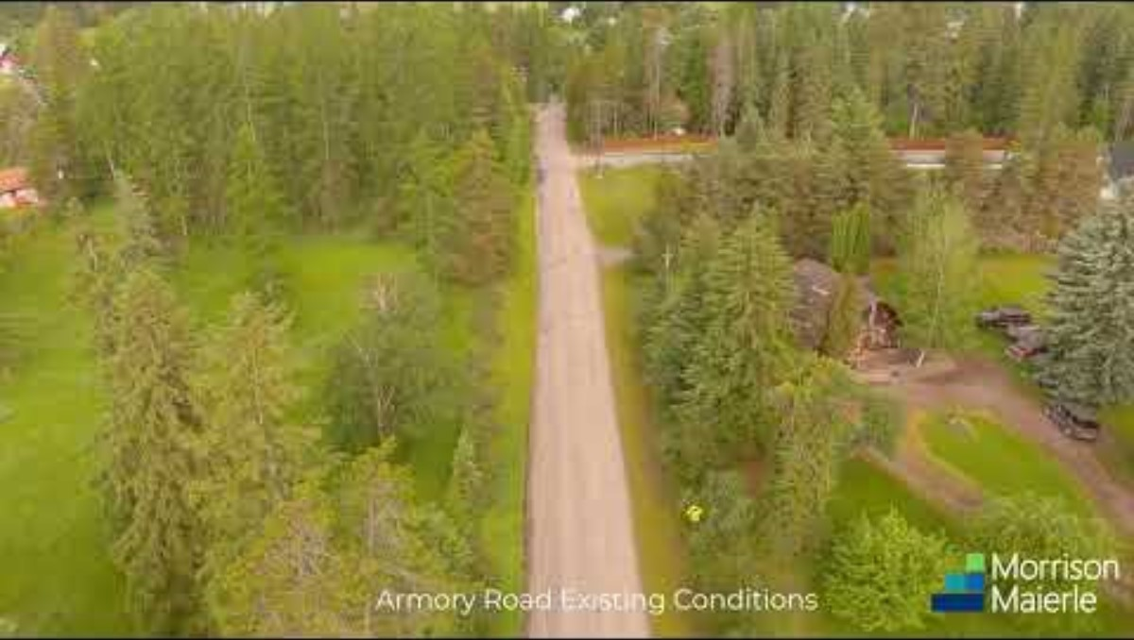

Slide 2


Armory Road Reconstruction
Engineering design awarded to
Morrison-Maierle on 08/05/2024
Step 1: One-Way Couplet &
Raised Median Traffic Trials
September 26th, 2024 - Public Meeting #1

Slide 3

Welcome!
Thank You For Coming!

Slide 4
Your Project Team
City of Whitefish:
Craig Workman, PE – Public Works Director
Karin Hilding, PE – Engineering and Sustainability Project Manager
Morrison-Maierle:
Ben Miller – Project Manager
Bryan Vanderloos, PE - Design Manager
Hannah Shephard – Public Outreach Coordinator

Slide 5
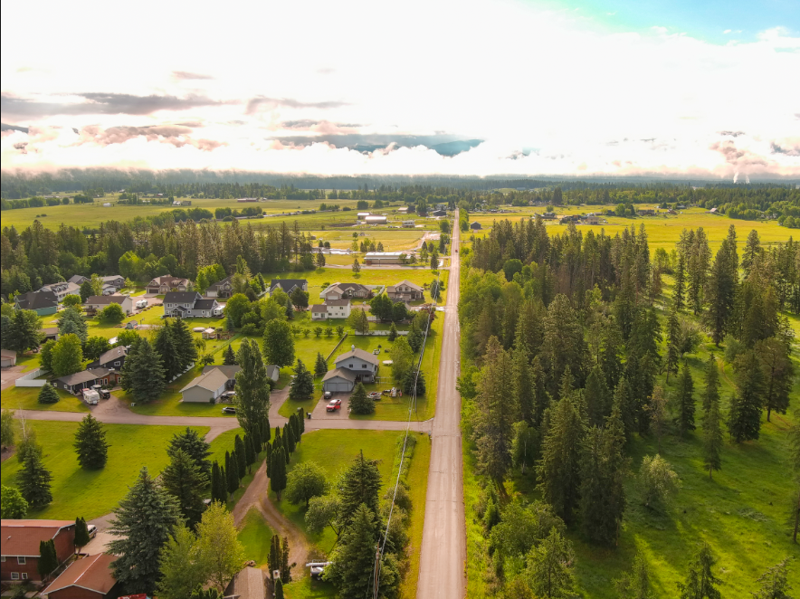
Project Background

Slide 6
Project Overview
Our project team recognizes that Armory Road is a collector street, and there is a need to improve the existing roadway geometry to prevent incidents at the hairpin turn located on Armory Road. There is also a need for safe pedestrian walkways.
In addition to the traffic calming alternatives, the project team proposes the following design improvements for Armory Road:
Sidewalks and/or multi-use paths for safe pedestrian
^{walkways.}
Reconstruction of the vertical curves on Armory Road.
New roadway signs and pavement markings meeting the Manual on Uniform Traffic Control Devices (MUTCD) requirements.

Slide 7
Why Traffic Trials?
We are initiating two traffic trials with the primary goal of gathering essential data. These trials, which include:
^{Raised Median.}
^{One-Way Couplet.}
This data will be crucial in determining the following:
The best traffic calming solution.
The most beneficial reconstruction plan for the entirety of Armory Road.
Ensuring it effectively meets community needs.

Slide 8
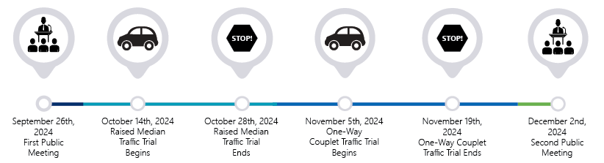
Projected Traffic Trials Schedule

Slide 9

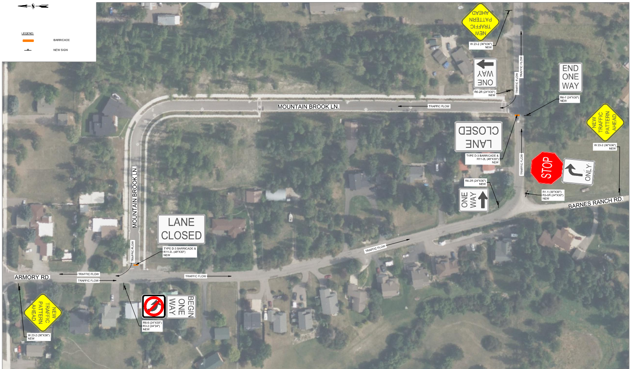
ALTERNATIVE 1: RAISED MEDIAN TRAFFIC TRIAL
TRAFFIC CANDLES WILL BE PLACED ALONG THE CENTERLINE OF ARMORY ROAD THROUGH THE CURVE.
DATA COLLECTORS WILL BE USED TO MONITOR THE AREA.
MORRISON-MAIERLE WILL OBSERVE TRAFFIC OPERATIONS ON THE RAISED MEDIAN TRAFFIC TRIAL.

Slide 10
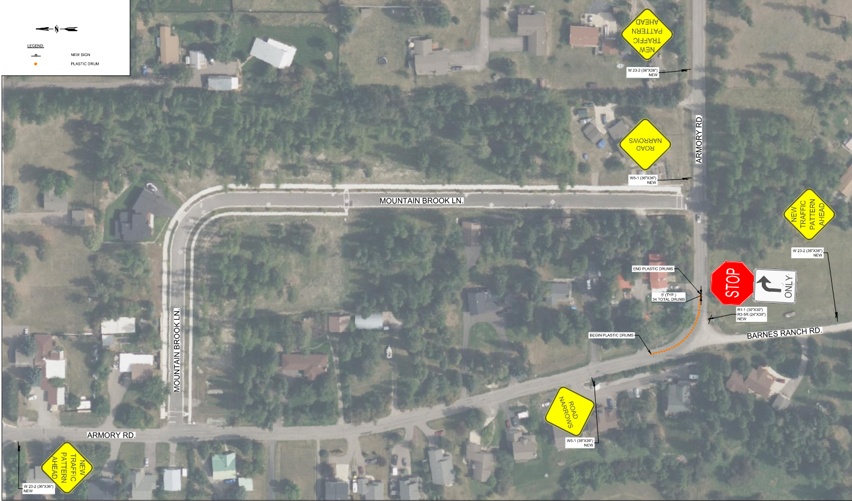
ALTERNATIVE 2:
ONE-WAY COUPLET TRAFFIC TRIAL
SIGNAGE AND BARRIERS WILL BE PLACED TO DIVERT WEST/NORTHBOUND TRAFFIC FROM ARMORY ROAD ONTO MOUNTAIN BROOK LANE.
ALL EAST/SOUTHBOUND TRAFFIC ON ARMORY ROAD WILL OPERATE “AS-IS.”
DATA COLLECTORS WILL BE USED TO MONITOR THE AREA.
MORRISON-MAIERLE WILL OBSERVE TRAFFIC OPERATIONS ON THE ONE-WAY TRAFFIC TRIAL.

Slide 11
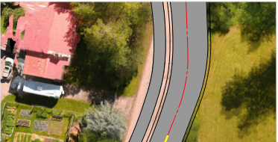
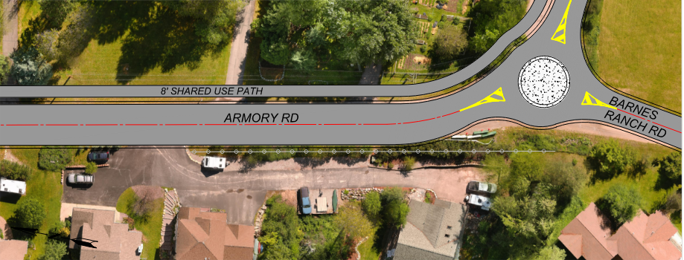
ALTERNATIVE 3:
MINI-ROUNDABOUT
Implementing a mini-roundabout near the intersection with Barnes Ranch Road would significantly improve traffic operations and reduce the speed of traffic entering the intersection. The significant benefits of a
mini-roundabout on Armory Road includes:
Higher reduction in motorist speed, which will equate to more efficient traffic calming
Improved traffic operations and motorist safety at the Barnes Ranch Road intersection.
Improved access management from the raised center median alternative.

Slide 12
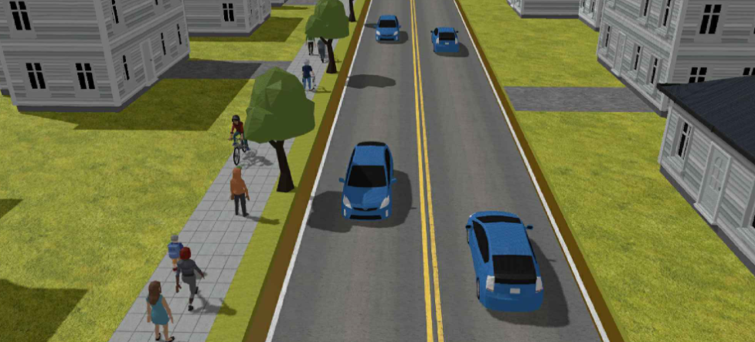
Sidewalk and Multi-Use Path

Slide 13
Frequently Asked Questions
When is construction projected to begin?
  ^{2026.}
Are these two traffic trials the only options being considered for reconstructing Armory Road?
  These two traffic trials are meant to gather traffic operation data. At the end of the two traffic trials, Morrison-Maierle will review the data and develop a design that best suits Armory Road.
Why is there survey equipment and paint on the roads?
  Surveying will be completed to locate utilities and gather as much data as possible to make an educated decision to reconstruct Armory Road.
Will sidewalks, bike lanes, or multi-use paths be designed for Armory Road?
  Yes, there will be sidewalks and/or a multi-use path designed for Armory Road to ensure safe and convenient access for pedestrians, cyclists, and other users.

Slide 14



Please download and install the Slido app on all computers you use
Questions or Concerns?
ⓘ Start presenting to display the poll results on this slide.

