Slide 1


Armory Road Reconstruction
Engineering design awarded to
Morrison-Maierle on 08/05/2024
Step 1: Raised Median Traffic Trials
December 4, 2024 - Public Meeting #2

Slide 2
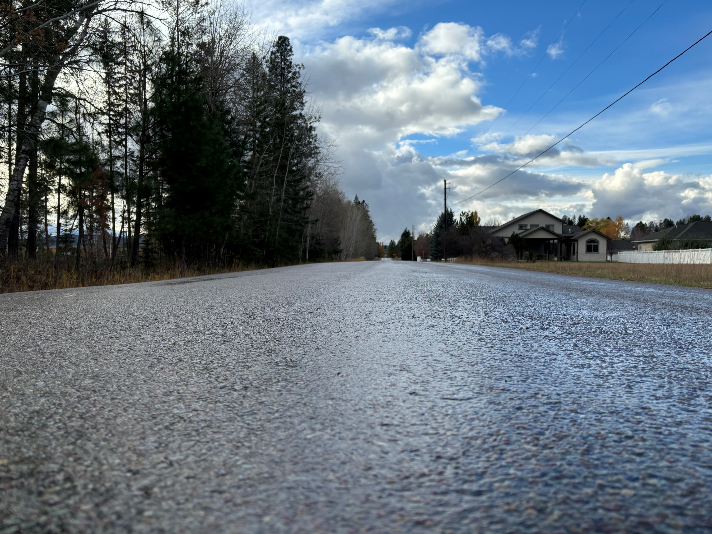
Welcome!
Thank You For Coming!

Slide 3
Your Project Team
City of Whitefish:
Craig Workman, PE – Public Works Director
  cworkman@cityofwhitefish.org – (406) 863-2455
Karin Hilding, PE – Engineering and Sustainability Project Manager
  khilding@cityofwhitefish.org – (406) 863-2450
Morrison-Maierle:
Ben Miller – Project Manager
  bmiller@m-m.net – (406) 261-5154
Bryan Vanderloos, PE - Design Manager
  bvanderloos@m-m.net – (406) 495-3423
Hannah Shephard – Public Outreach Coordinator
  hshephard@m-m.net – (406) 751-5840

Slide 4
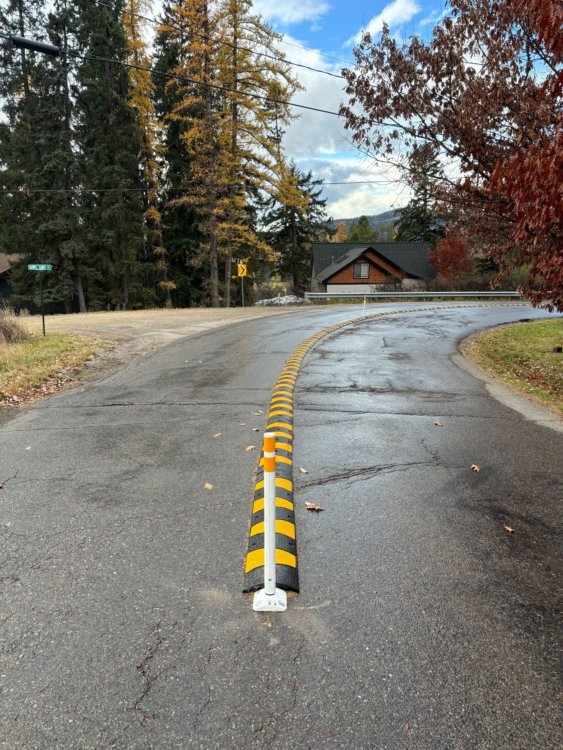
Project Background
Armory Road, a collector roadway, has seen increased traffic due to the City’s growth. A 2022 study showed 844 weekday and 616 weekend trips. The Armory Road Reconstruction Project will design and construct approximately 3,050 ft from E. 2nd Street to Dodger Lane.
The Traffic Trial
The Traffic Trials for the raised center median took place between October 2nd - November 1st, 2024
Pretesting was completed to establish a baseline of information.
Traffic delineators were strategically placed along the centerline.
Cameras and data collection devices were used to gather detailed information

Slide 5
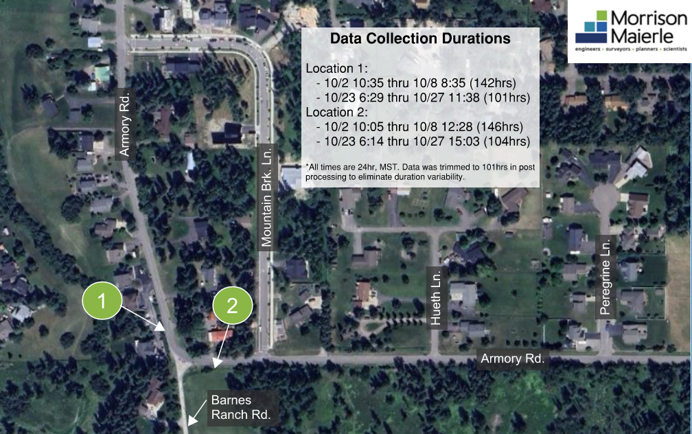

Figure 1:
Data Collection Location and Duration
Consistent camera placement for pre- and post-installation data collection.
Start times are consistent within 30 minutes for each respective data collection period.
All collected data is trimmed to 101 hours to eliminate data collection period duration variance.
N

Slide 6
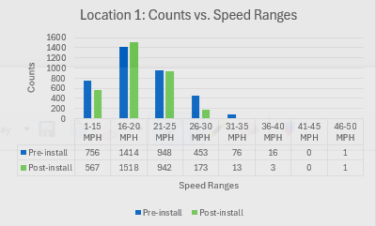
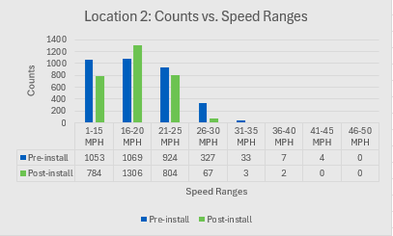
Figure 2:
Locations 1 & 2 Average Speed Comparison Charts
These charts display the total volume of vehicles traveling at each speed range for each data collection period.
Significant decrease in 26mph+ volumes post-installation of the temporarily raised median.
Increase in 16-25mph speed ranges post-installation consistent with decrease in 26mph+.
Data collection duration is consistent across all locations/data collection periods (101 hours), total counts are not.

Slide 7

Figure 3:
Average Speed Comparison Table
Key takeaways:
  NB/WB indicates the same lane/direction of travel down Armory Rd. Given the 90-degree turn, SB/EB is vice versa.
  NB/WB lane average speeds were reduced significantly by installing the temporarily raised median, and SB/EB average speeds were reduced by a negligible amount.
  Overall average speeds at each location were reduced by 5% or greater.
*NB = Northbound, SB = Southbound, EB = Eastbound, WB = Westbound

Slide 8
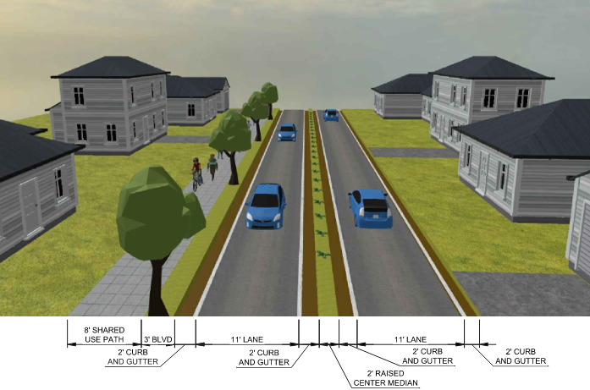
Armory Road Raised Median Typical Section

Slide 9
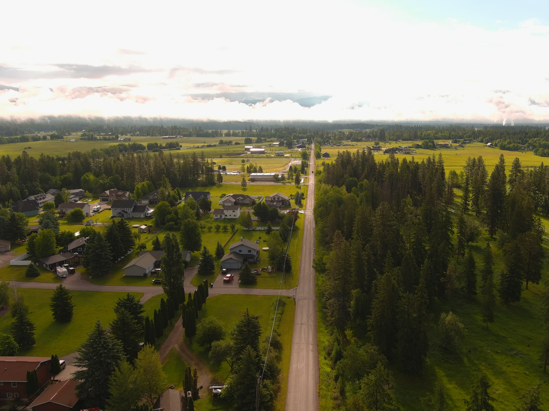
What’s Next?

Slide 10
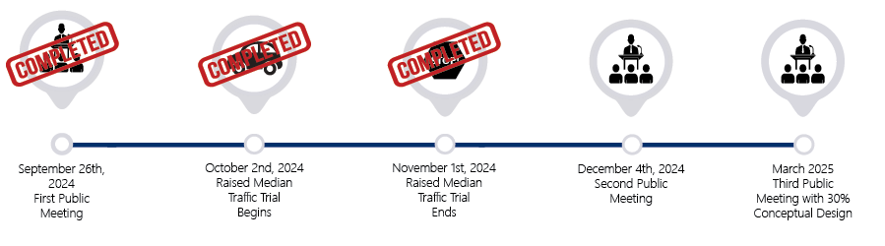
Project Schedule

Slide 11
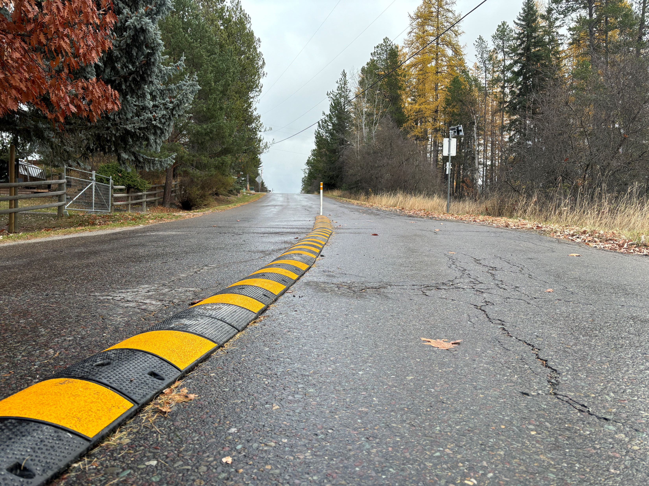
Questions or Comments?

